Slide 1
Data science manager: qualifications and skills
Jeff Leek
@jtleek
www.jtleek.com

Slide 2
What does a data science manager do?
Builds a data team
Sets goals and priorities
Manages data science process
Interacts with other groups

Slide 3

http://www.liquidplanner.com/blog/8-ways-to-become-a-big-data-project-manager-no-data-science-required/

Slide 4
What skills do they need?
Knowledge of software/hardware
Knowledge of roles
Knows what can and can’t be achieved
Strong communication

Slide 5
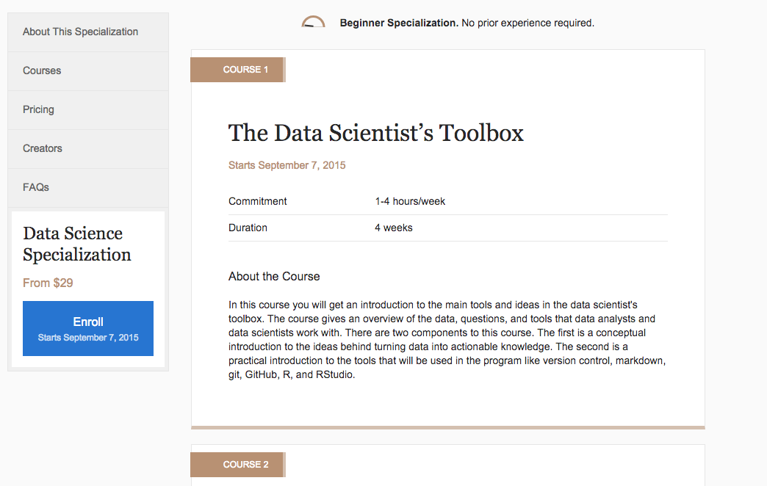
https://www.coursera.org/specializations/jhudatascience

Slide 6
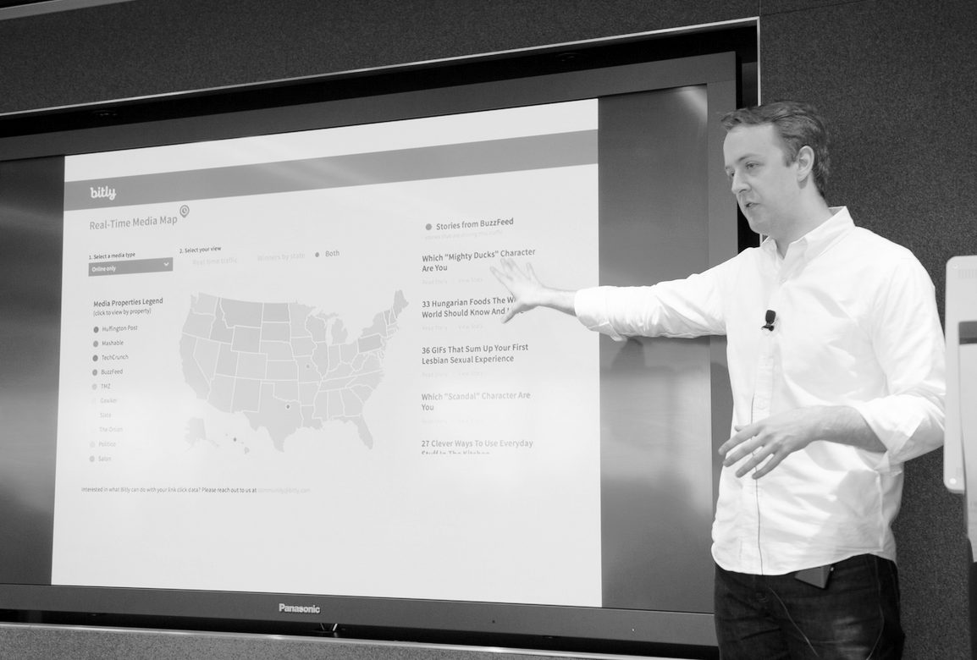
Source NYC Media Lab: http://bit.ly/1EQcWAn

Slide 7
Background of data managers
Data science + management
Data engineering + management
Management + training in data science

Slide 8
https://www.coursera.org/specializations/jhudatascience

Slide 9
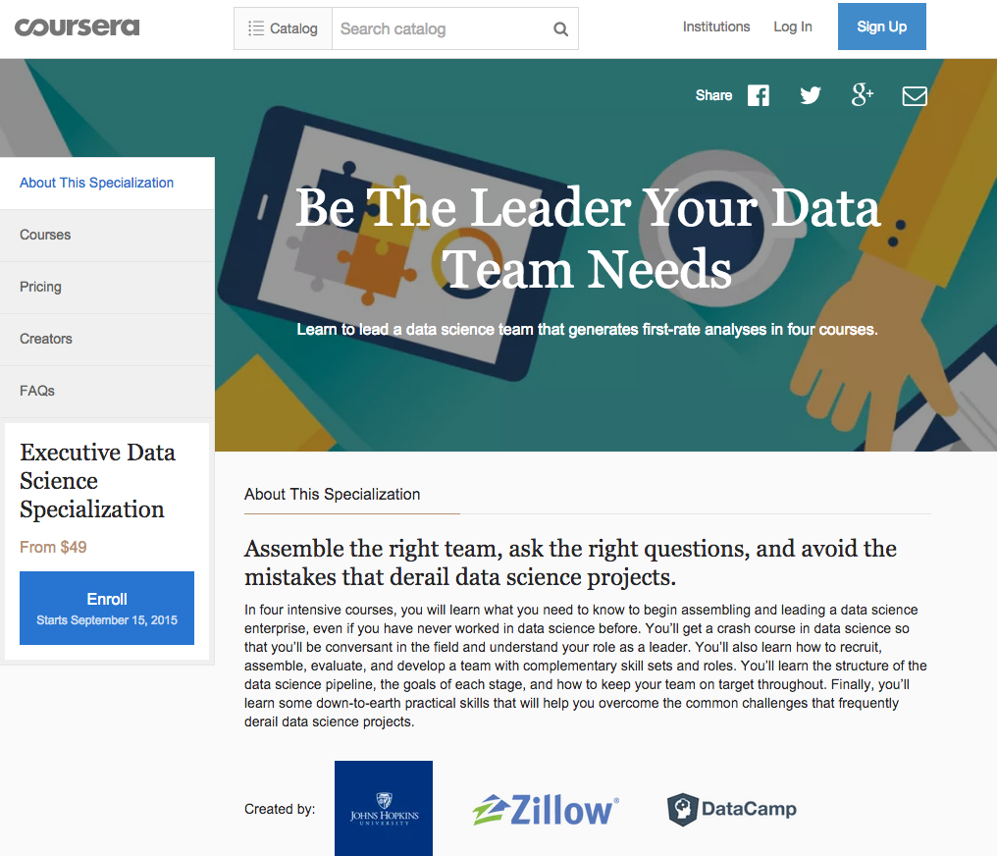
https://www.coursera.org/specializations/executive-data-science

Slide 10
Key characteristics
Knowledgeable
Supportive
Thick skinned
Polite but relentless

Slide 11
Data engineering
Data science
Managing People

